Slide 1
FOOD ORDERING SYSTEM
Manduul Enkhee 961800
Munkhzorig Bayartsogt 610557
Odbayar Nanjidjamts 610526
Tuvshintur Batzorig 610561
Davaabayar Battogtokh 610567

Slide 2
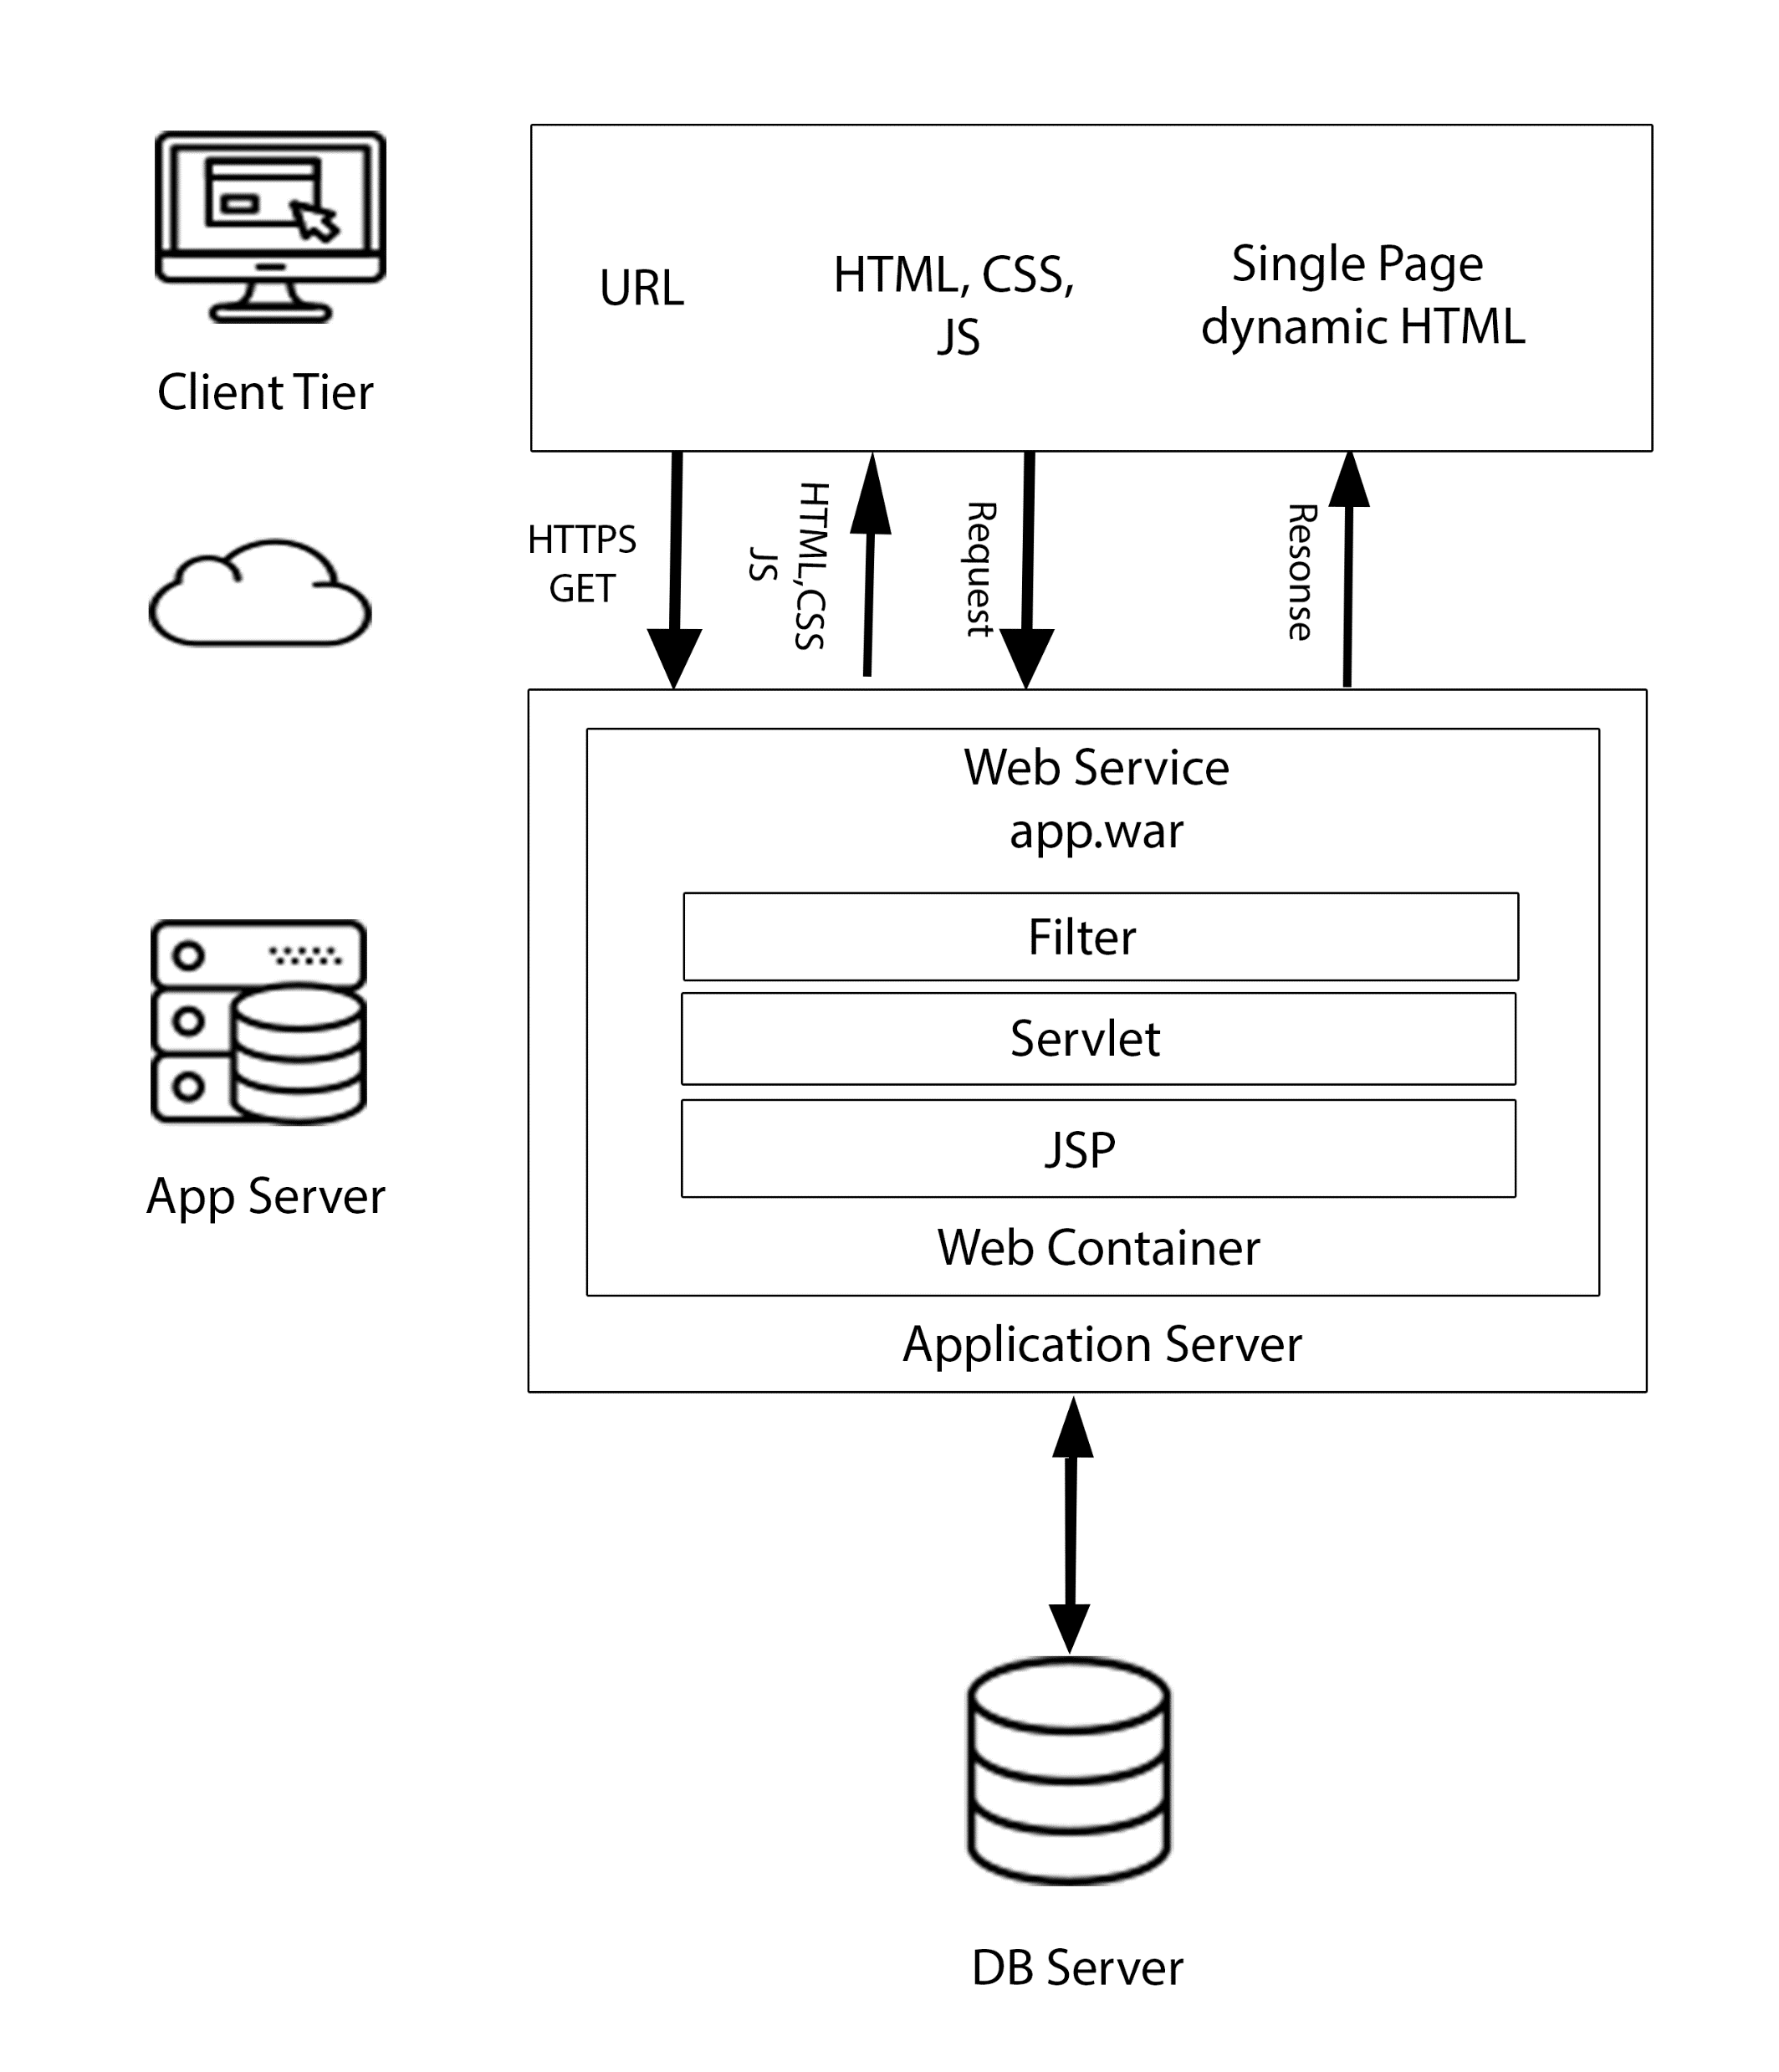
ARCHITECT

Slide 3
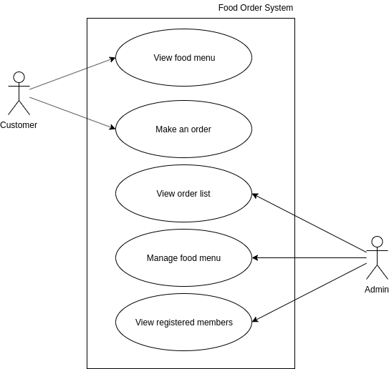
USE CASE

Slide 4
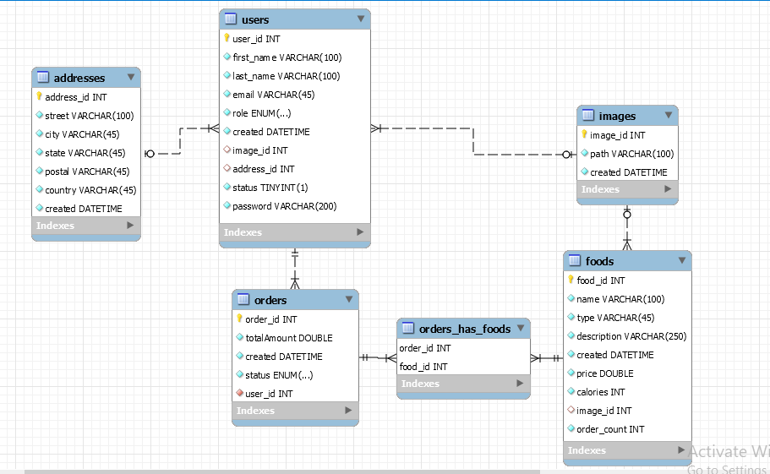
ENTITY RELATIONSHIP DIAGRAM

Slide 5
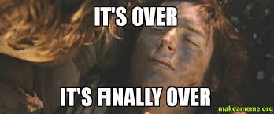
THANKYOU

